Slide 1
HSC minimum standard
Information for students

Slide 2
What is the HSC minimum standard?
From 2020, students in NSW must meet a minimum standard of literacy and numeracy to be eligible for the HSC credential.​
The HSC minimum standard is set at Level 3 of the Australian Core Skills Framework (ACSF)​.
ACSF is a nationally agreed set of standards, endorsed by federal and state education ministers​.
The HSC minimum standard is a practical level of reading, writing and numeracy used in everyday life, for work and further study​.

Slide 3
How do students meet the minimum standard
HSC 2020
Students have 2 pathways to meet the
minimum standard:
1. attained a band 8 in Reading, Writing
and Numeracy in the 2017 year 9 NAPLAN tests.
2. sit the Reading, Writing and Numeracy
minimum standards online tests.
HSC 2021 and beyond
Students will meet the minimum standard by sitting the HSC minimum standard online tests in Reading, Writing and Numeracy and attaining a level 3.

Slide 4
HSC minimum standard tests
There are three separate 45 minute online tests
Reading Test – 45 multiple choice questions ​
​
Numeracy Test – 45 multiple choice questions ​
​
Writing Test – one response of up to 500 words based on a choice from two prompts. (Typed / marked by NESA examiners)​
Students can only attempt each test twice in a calendar year in years 10, 11 and 12

Slide 5
Practice tests
There are three separate 15 minute online practice tests
Practice tests can be taken at any time through out the year at school.
They can be taken as many times as needed to help get ready for the minimum standard tests.
There are also demonstration tests on the NESA website you can access from home.
​

Slide 6
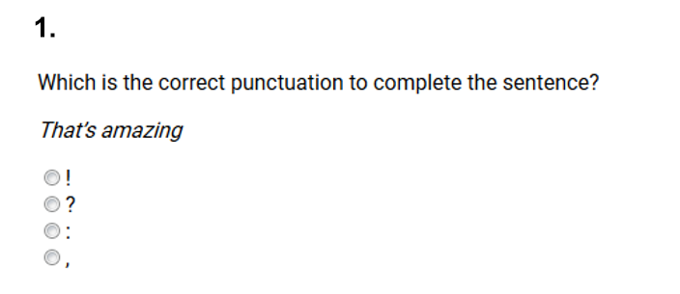
Sample Reading test questions

Slide 7
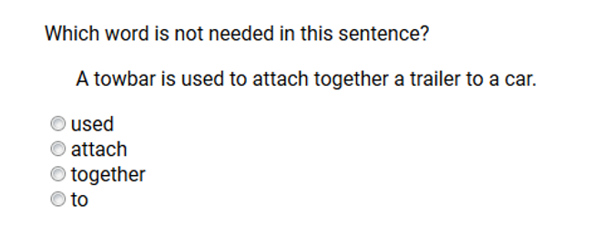
Sample Reading test questions

Slide 8
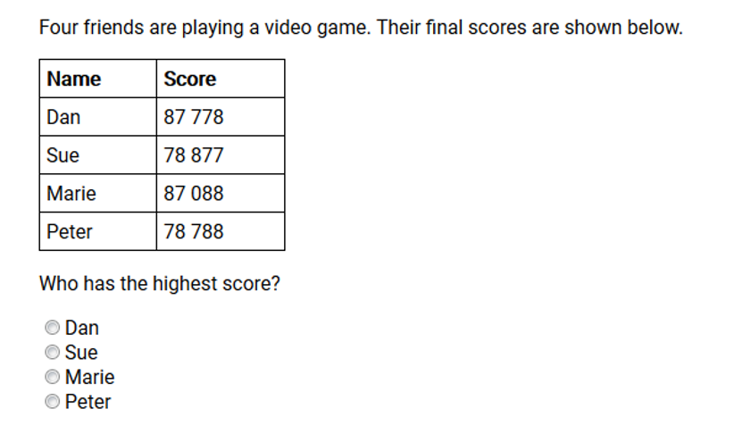
Sample Numeracy test questions

Slide 9
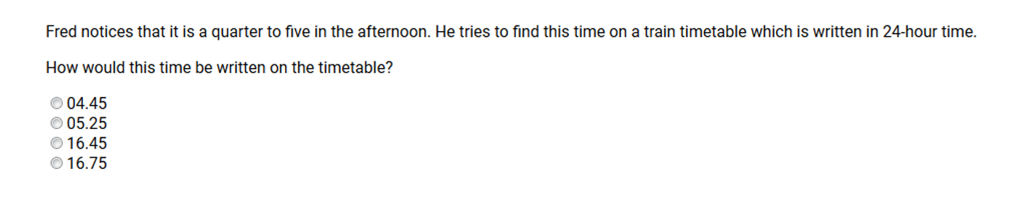
Sample Numeracy test questions

Slide 10
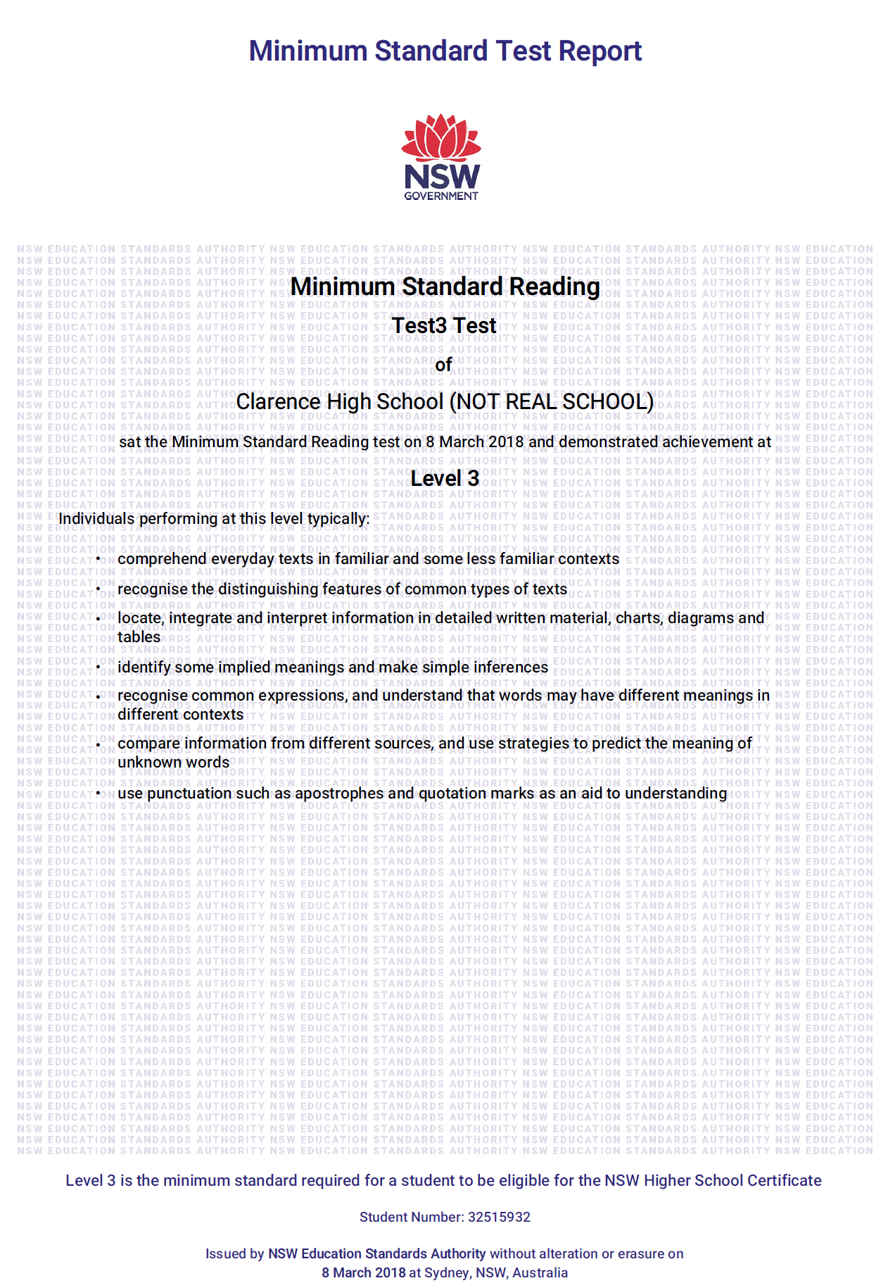
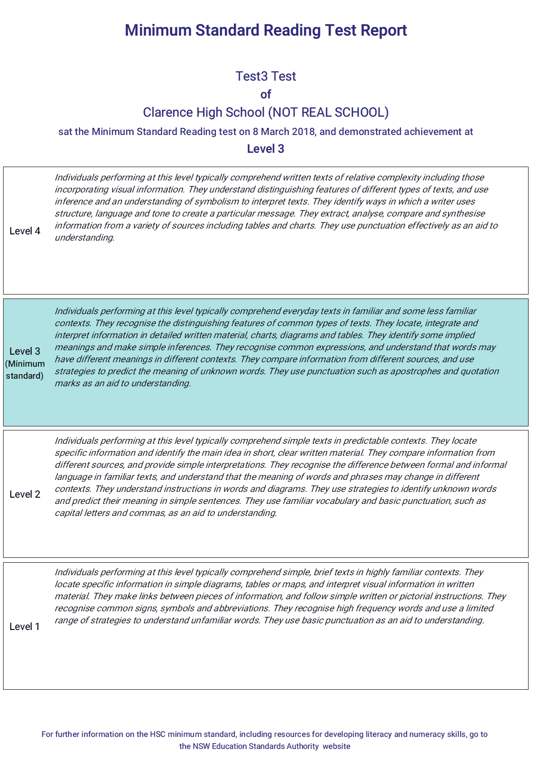
Certification
HSC Minimum Standard Report
These certificates can be downloaded from Students Online.

Slide 11
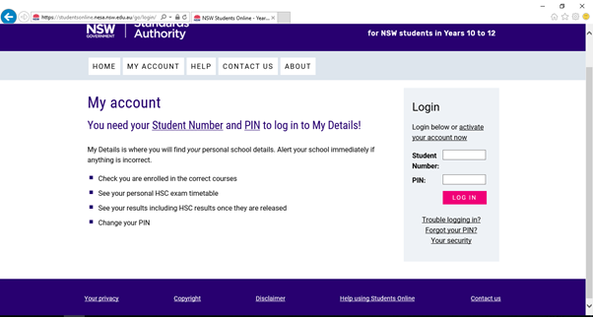
Students Online
https://studentsonline.nesa.nsw.edu.au
Notes:
This is where you access your account.

Slide 12
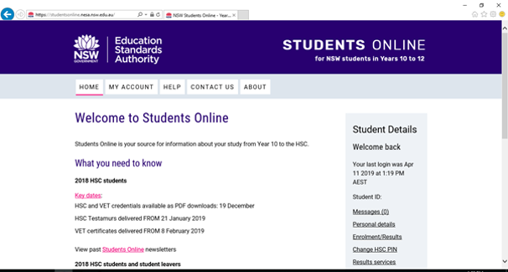
Students Online
https://studentsonline.nesa.nsw.edu.au

Slide 13
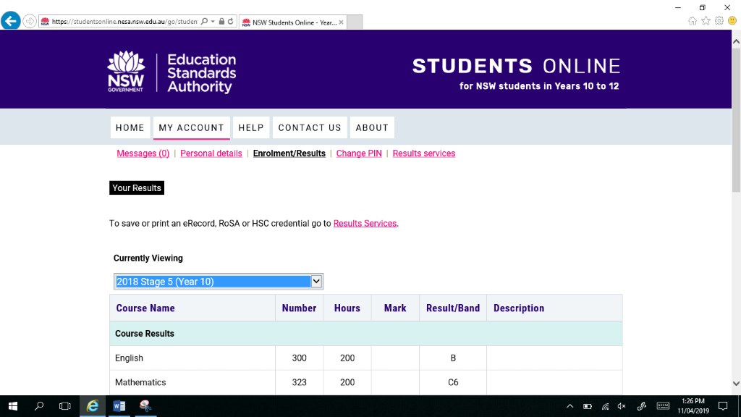
Students Online
https://studentsonline.nesa.nsw.edu.au

Slide 14
Test provisions
Some students might be eligible for test provisions, such as:
breaks in the test
extra time, or
separate supervision.
Talk to the Learning Support team or Year Adviser if you think you might be eligible for test provisions.

Slide 15
What if a student does not meet the standard?
Study HSC courses
If a student does not meet the HSC minimum standard they can still:
Sit the HSC exams
Receive a ROSA
Receive an ATAR
Receive a HSC Minimum Standard Report

Slide 16
HSC minimum standard pathways for students
HSC 2020
Student | Action | Eligible for credential
Achieved band 8 in NAPLAN 2017 in Year 9 in Reading, Writing and Numeracy. | No minimum standard test required | HSC ROSA
Did not achieve band 8 in NAPLAN 2017 in 1, 2 or 3 of the following areas- Reading, Writing or Numeracy. | Students only have to sit the online HSC minimum standard test for the areas that they did not achieve band 8 in NAPLAN. Students can have up to 5 years from the start of the HSC to re-sit the minimum standard tests to achieve level 3 in Reading, Writing and Numeracy. Student then achieves level 3 in Reading, Writing and Numeracy. | HSC ROSA Minimum Standard Report
Did not achieve Band 8 in NAPLAN 2017 in 1, 2 or 3 of the following areas – Reading, Writing and Numeracy. Does not achieve Level 3 in the HSC minimum standard online tests. | Students only have to sit the online HSC minimum standard tests for the areas that they did not achieve band 8 in NAPLAN. Students can have up to 5 years from the start of the HSC to re-sit the minimum standard tests to achieve level 3 in Reading, Writing and Numeracy. | ROSA Minimum Standard Report If studying an ATAR pattern of study students can still receive ATAR and offer to university.
Does not qualify for HSC due to ‘N’ determination or ineligible pattern of study. | Sits the minimum standard tests to attain a Minimum Standard Report. | ROSA Minimum Standard Report
Leaves school when 17, before the end of Year 12. | Sits the 3 minimum standard tests to attain a Minimum Standard Report. | ROSA Minimum Standard Report
Leaves school when 17. | Does not sit any of minimum standard tests. | ROSA

Slide 17
HSC minimum standard pathways for students
HSC 2021 and beyond
Student | Actions required | Eligible for credential
Achieves Level 3 in the HSC minimum standard tests (reading, writing, numeracy) before end of Year 12. | Students only have to demonstrate they have met the standard once. Students can choose an ATAR or non ATAR pattern of study in the HSC. | HSC ROSA Minimum Standard Report
Achieves Level 3 in one or two HSC minimum standard tests before the end of Year 12. | Students can have up to 5 years from the start of the HSC to sit the 3 HSC minimum standard online tests to achieve Level 3. | ROSA Minimum Standard Report If studying an ATAR pattern of study, students can still receive ATAR and offer to university.
Does not qualify for HSC due to ‘N’ determination or ineligible pattern of study. | Sits the 3 HSC minimum standard online tests to attain a Minimum Standard Report. | ROSA Minimum Standard Report
Leaves school when 17, before the end of Year 12. | Sits the 3 HSC minimum standard online tests to attain a Minimum Standard Report. | ROSA Minimum Standard Report
Leaves school when 17. | Does not sit any of the HSC minimum standard tests. | ROSA

